Slide 1
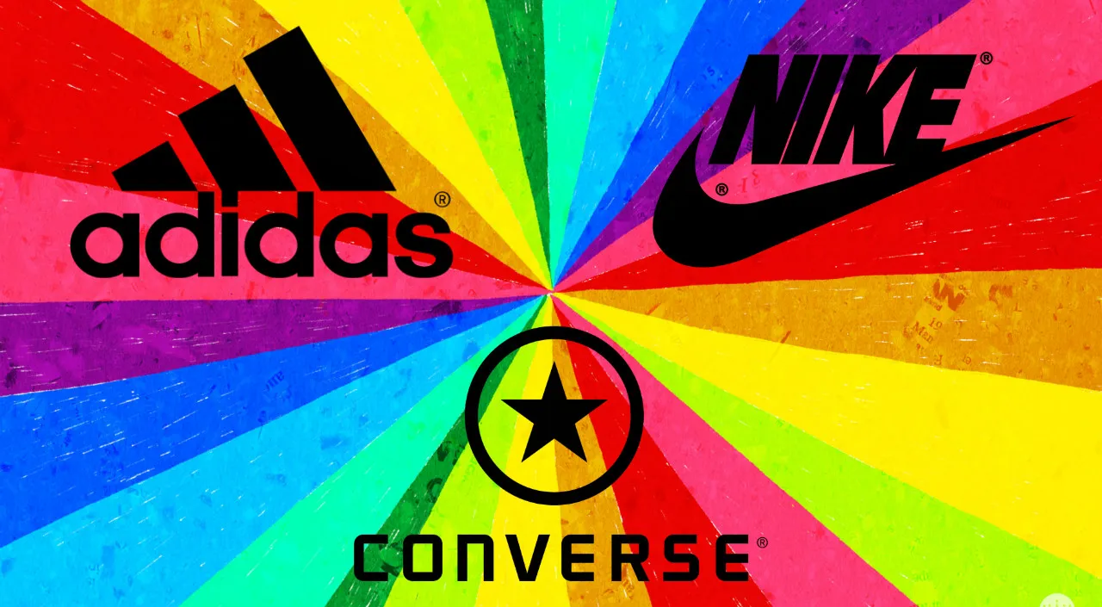
Brand Classification Project
by Oleg Budachov

Slide 2
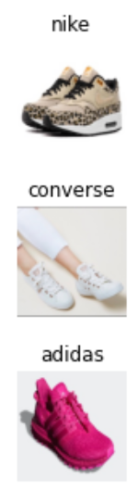
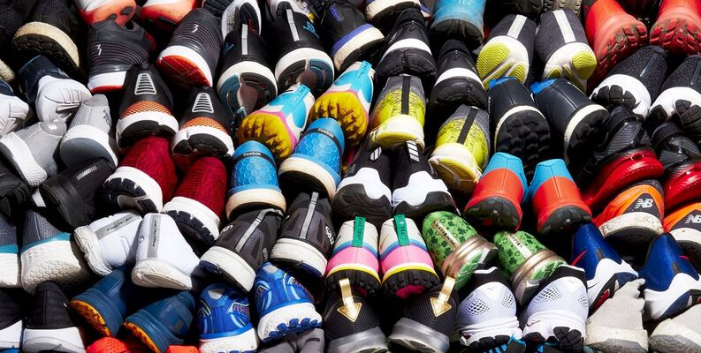
Primary goal of the project
The primary goal of this project is to categorize images of shoes into three distinct brands: Nike, Adidas, and Converse by employing transfer learning with the InceptionV3 model, a deep convolutional neural network (CNN) architecture developed by Google's research team, which is primarily designed for image classification and object recognition tasks.
Model
Images of shoes

Slide 3



2. Data overview
The dataset is structured into two folders, one for test data and the other for training data, with a test-train-split ratio of 0.14. The test dataset comprises 114 images, while the training dataset consists of 711 images. All images are in RGB color format and have a resolution of 240x240 pixels. Within both folders, there are three distinct classes: Adidas, Converse, and Nike.
This dataset was acquired by downloading images from Google Images in .webp format than they were converted to .jpg format. Subsequently, the images were randomly shuffled and resized to ensure a consistent resolution of 240x240 pixels for all samples.

Slide 4
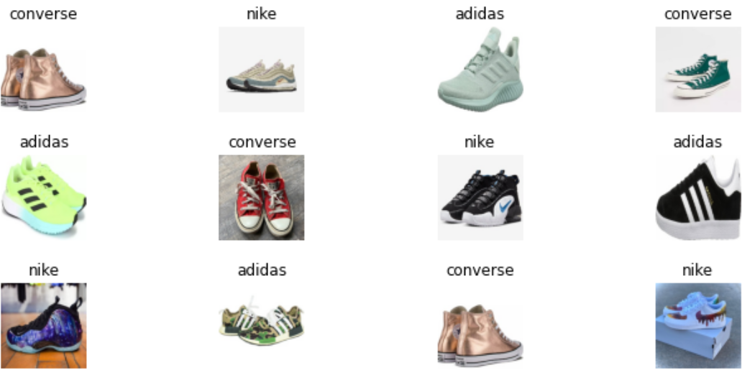
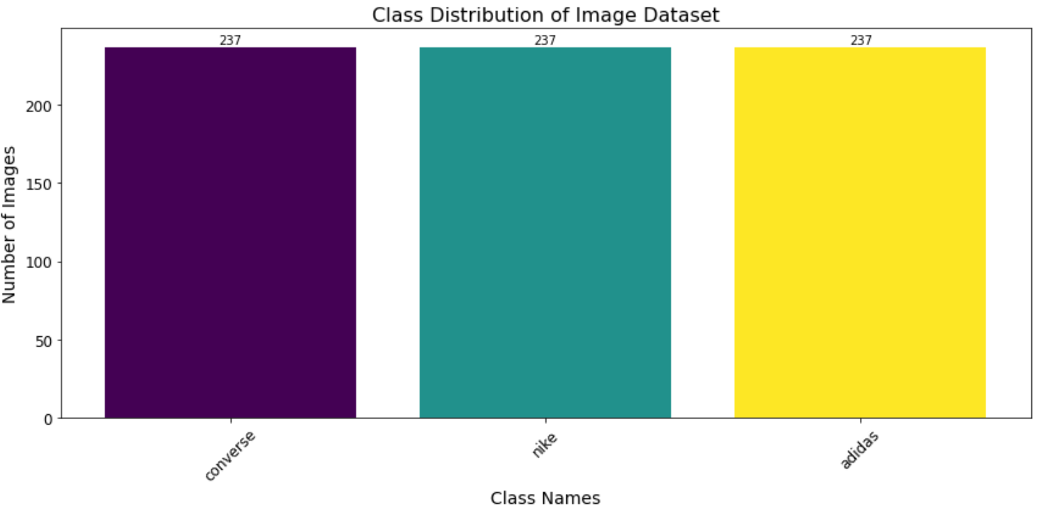
3. Data preprocessing and EDA
Let's confirm that our data is balanced across all three classes:
Let's visualize a random sample of images from our dataset, which can help us assess the quality of the data, check for any potential issues, and get a sense of the visual characteristics of our dataset:

Slide 5
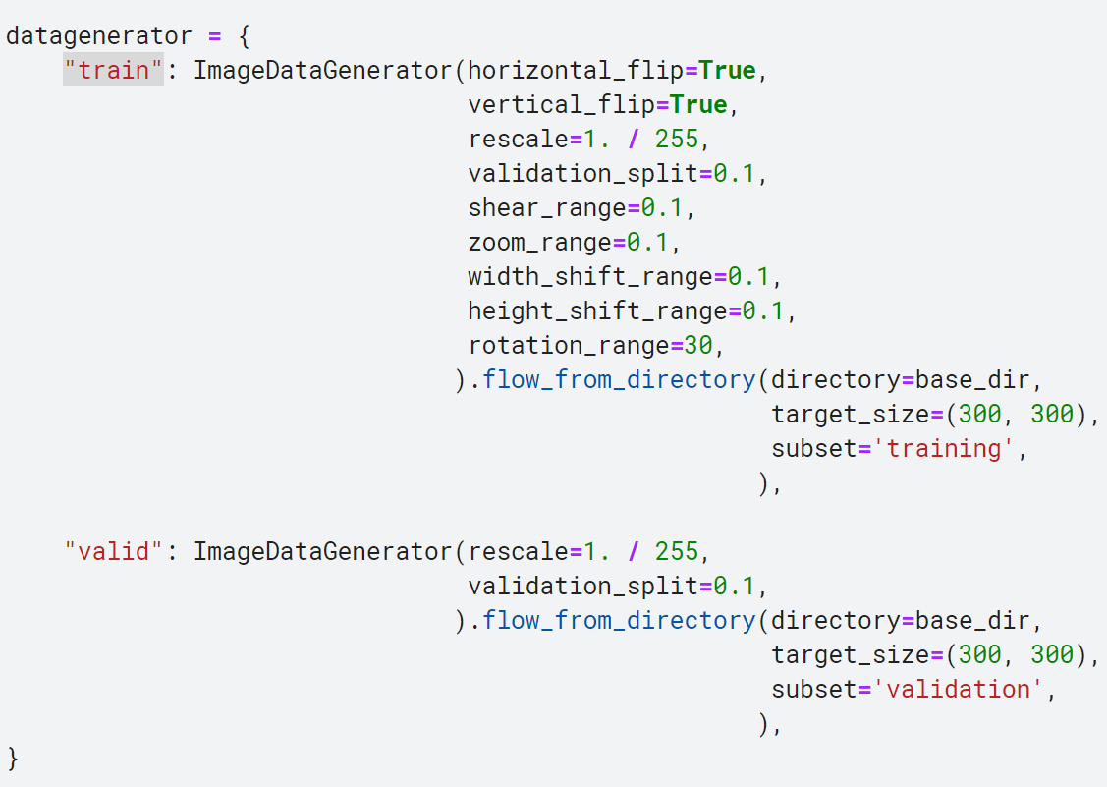
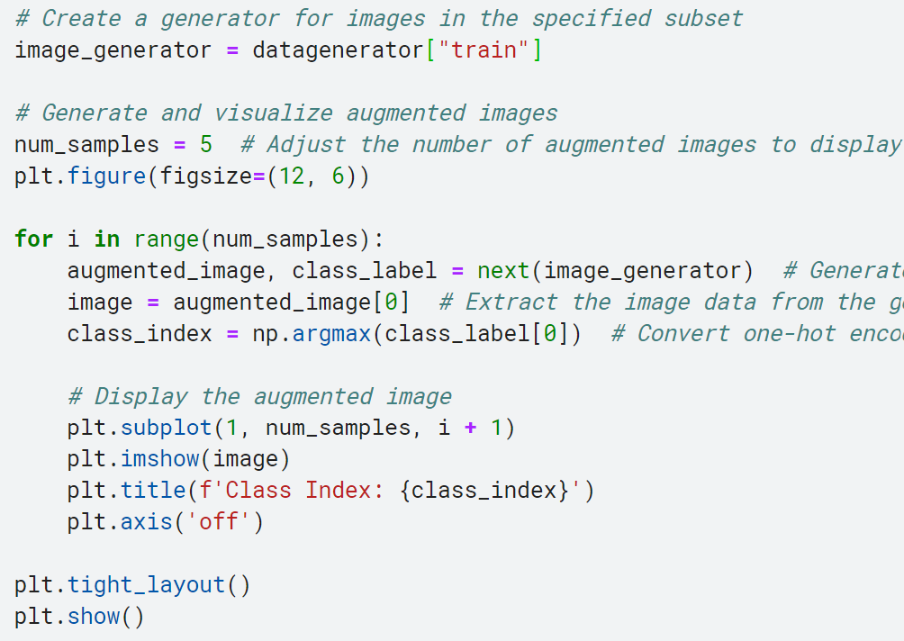
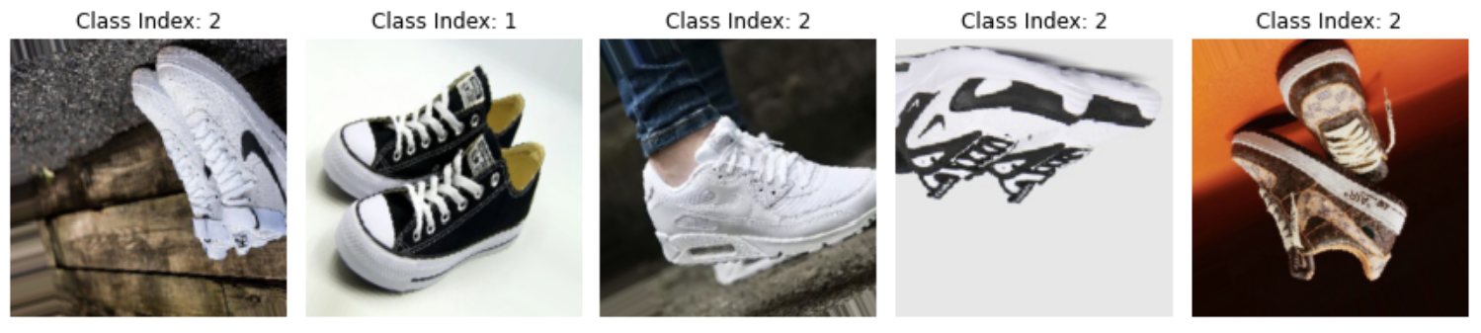

Slide 6
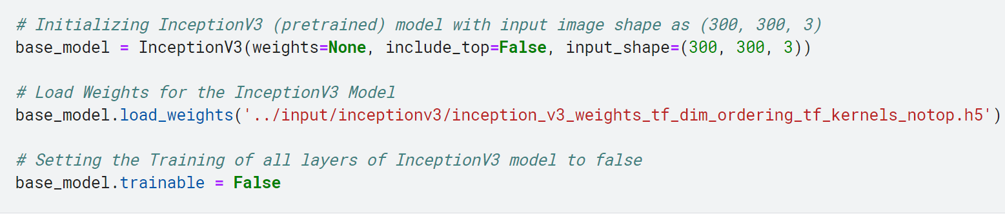
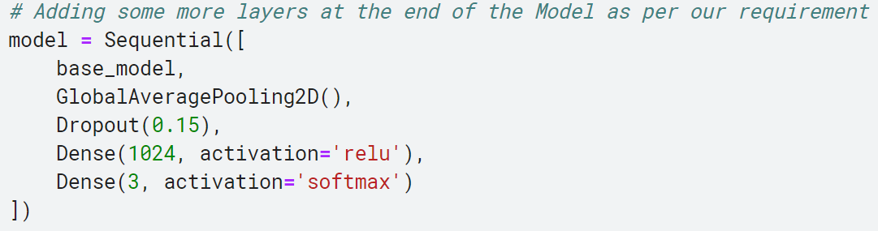
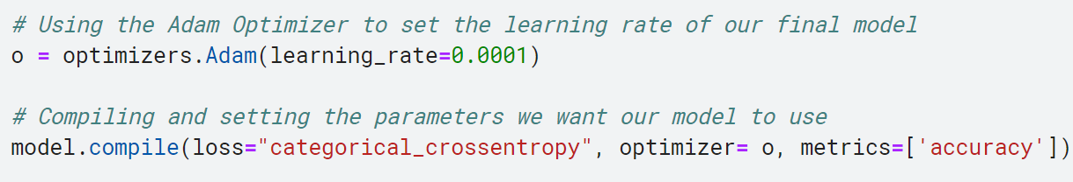
4. Model building: Initializing InceptionV3

Slide 7
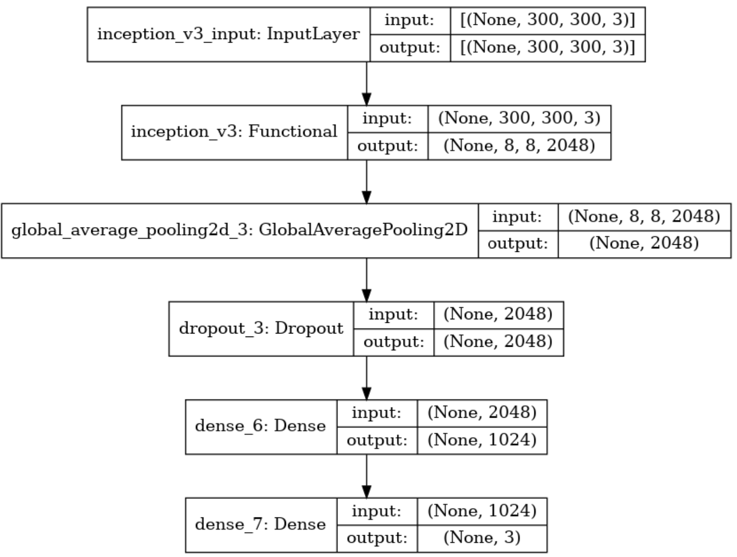
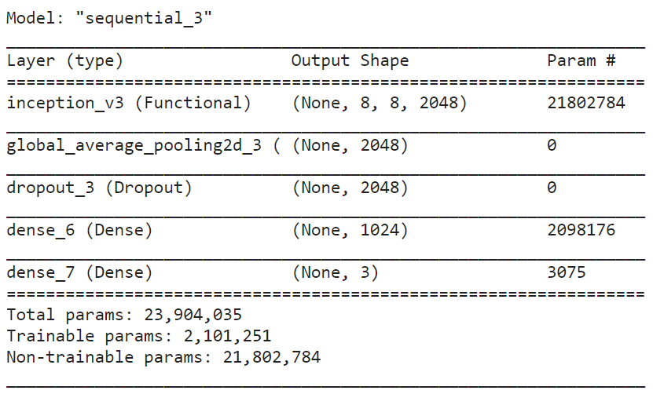
View model summary & plot

Slide 8
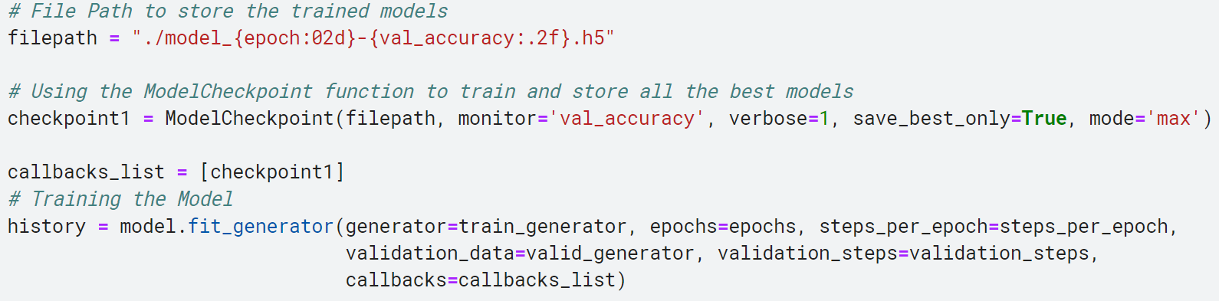
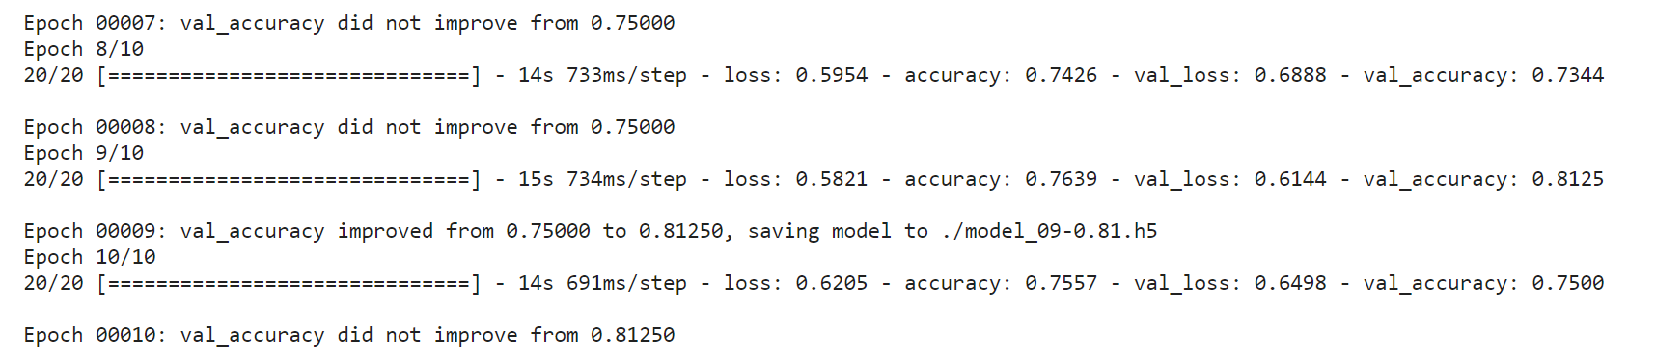
5. Model training

Slide 9
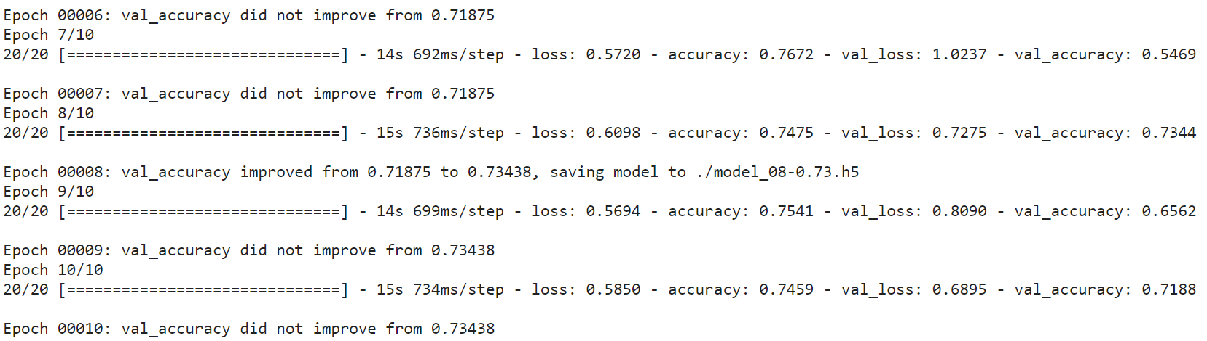
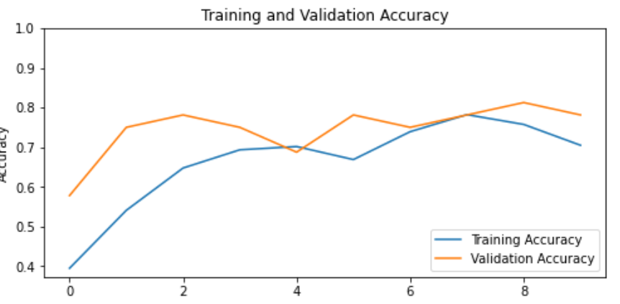
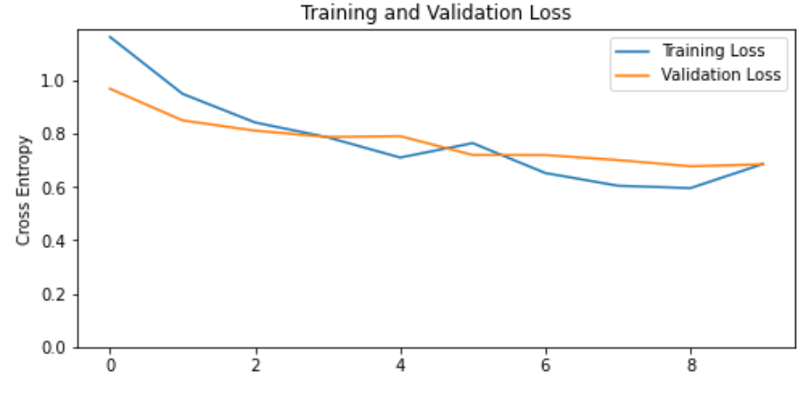
6. Model Evaluation and Tuning

Slide 10
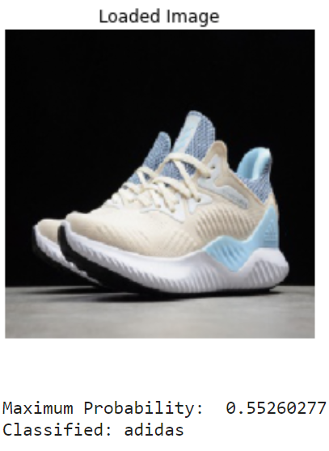
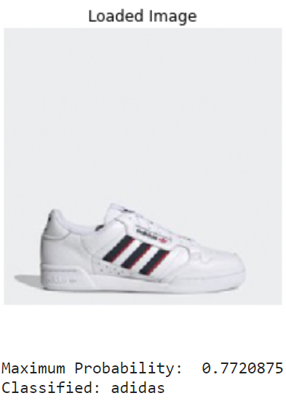
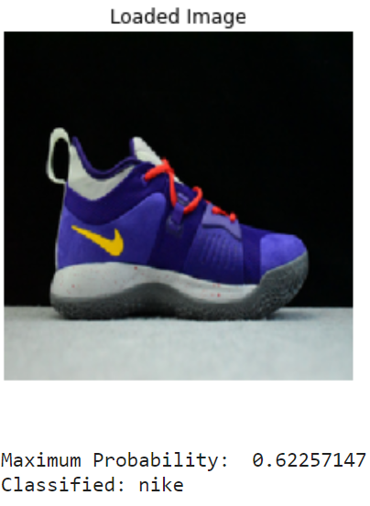
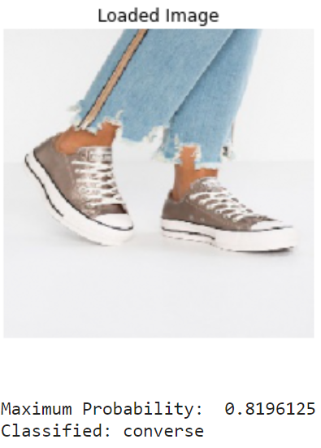
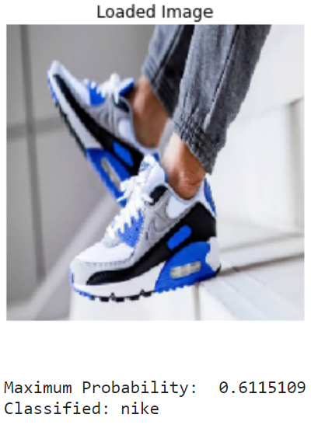
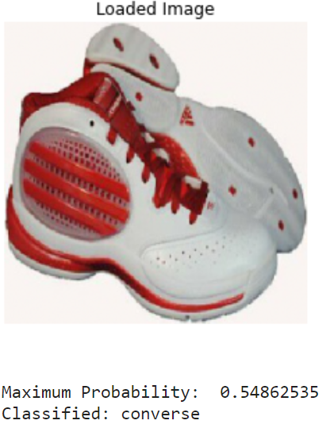
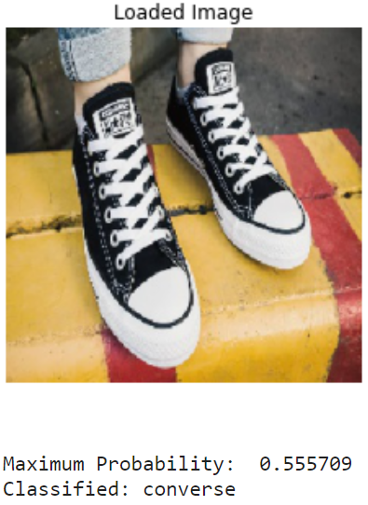
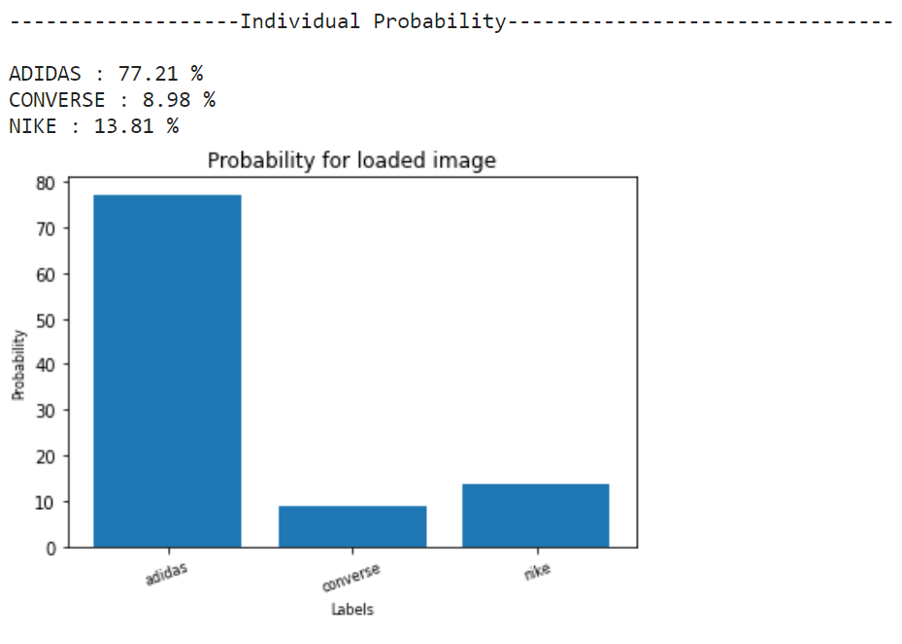
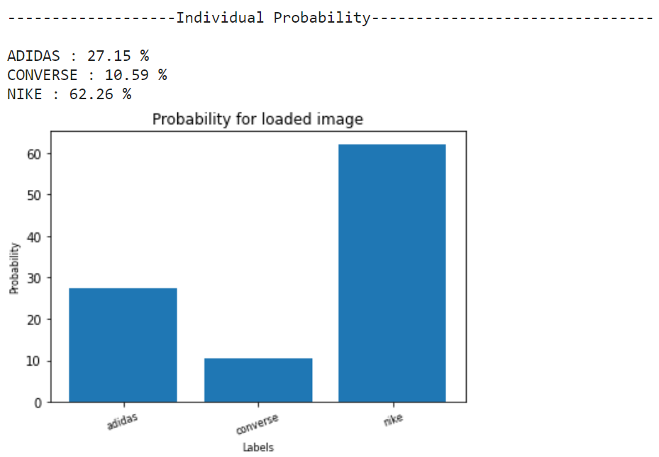
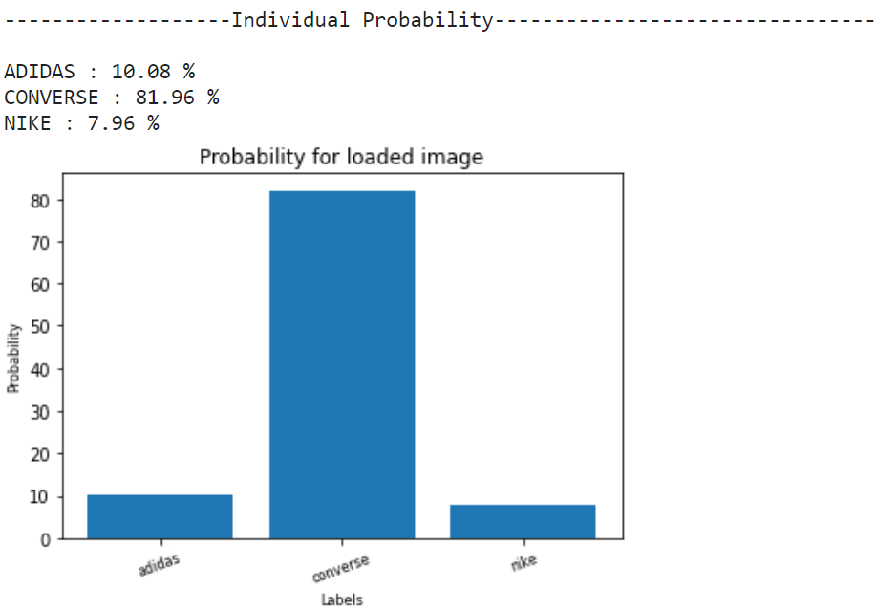
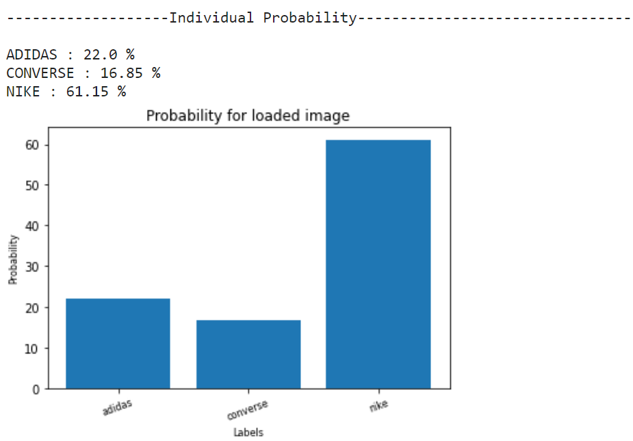
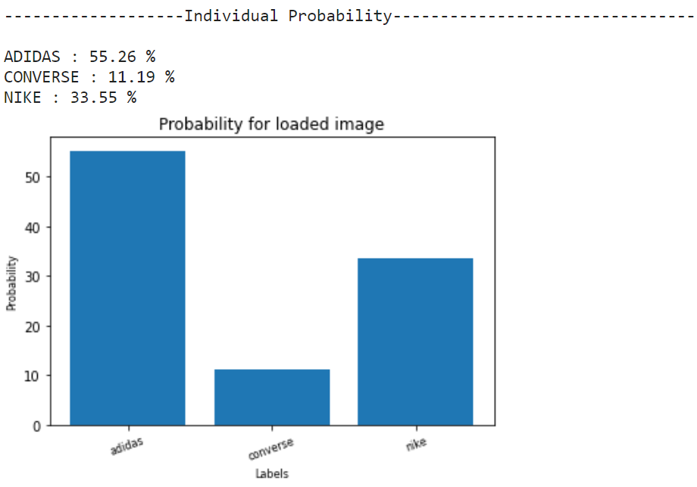
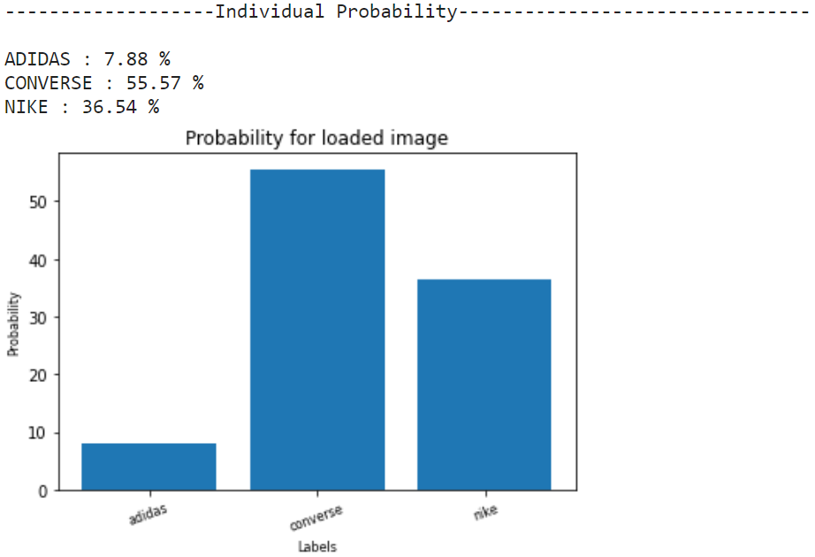
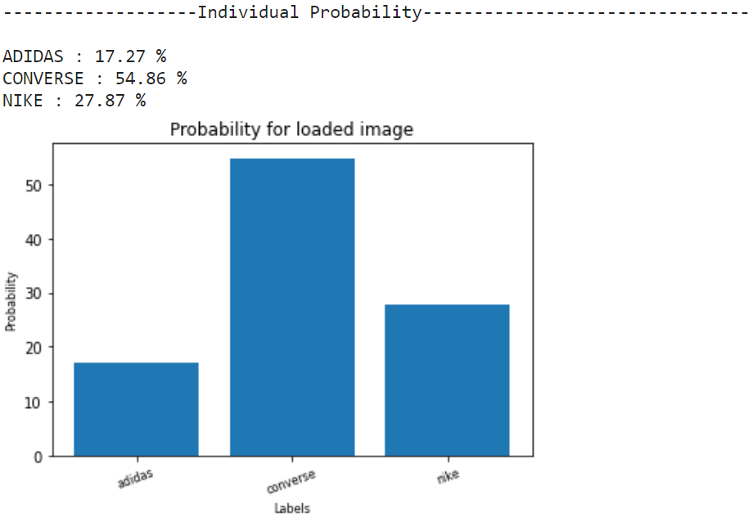
7. Model Testing With Graphs

Slide 11
8. Conclusion and further Improvements
Task: Image classification for shoe brands (Adidas, Converse, Nike).
Model: Deep learning based on InceptionV3 architecture.
Results: Achieved 78% test accuracy, demonstrating generalization.
Future Improvements:
Data Augmentation
Fine-Tuning
Hyperparameter Tuning
Regularization
Ensemble Learning
Advanced Metrics
Interpretability
Continuous Monitoring
Practical Applicability:
Successful classification of brand logos.
Model's relevance in real-world scenarios.

